Slide 1
Human Subject Protections Issues
Related to the COVID-19 Pandemic
Office of Research Protections, Policy, & Education
VHA Office of Research and Development
Department of Veterans Affairs
April 2, 2020
Dial in (Main): (914) 614-3221
Dial in (Alt): (914) 339-0024
Access Code: 727-588-181
Slides in “Handout” Tab

Slide 2
Discussion Points
Obtaining informed consent and written HIPAA authorizations: COVID-19 patients
VHA Directive 1200.05 Amendment: Use of commercial IRBs in VA research
Use of designated review by R&D Committees for review and approval of expanded access programs as regulated by the U.S. Food and Drug Administration
Modifications to previously approved research:
  Amendments vs. changes made to eliminate apparent immediate harm to human subjects
Use of video and communication technologies

Slide 3

Informed Consent: Subjects in COVID-19 Isolation
Informed consent is the cornerstone of ethical human subject protections under the Common Rule.
Unless waived by an Institutional Review Board (IRB), informed consent must be obtained from the subject or the subject’s legally authorized representative.
Written informed consent as approved by an IRB is required for human subjects research if the criteria for a waiver of informed consent or a waiver of documentation of informed consent are not met.
One cannot make informed consent optional when required by the IRB because the prospective subject is in COVID-19 isolation.

Slide 4

Informed Consent: Subjects in COVID-19 Isolation
FDA regulations require that the informed consent of a participant be documented by the use of a written consent form approved by the IRB and signed and dated by the subject or the subject’s legally authorized representative at the time of consent (21 CFR 50.27(a)).

Slide 5
How Can Written Informed Consent be Obtained from VA Research Subjects Who are in COVID-19 Isolation?
ORD and ORO have consulted with other federal agencies, including the Office for Human Research Protections (OHRP) and FDA, on obtaining written informed consent from research subjects who are in COVID-19 isolation.
ORD is in alignment with FDA’s guidance released on March 20, 2020 and updated on March 27, 2020 titled:
FDA Guidance on Conduct of Clinical Trials of Medical Products during COVID-19 Pandemic

Slide 6
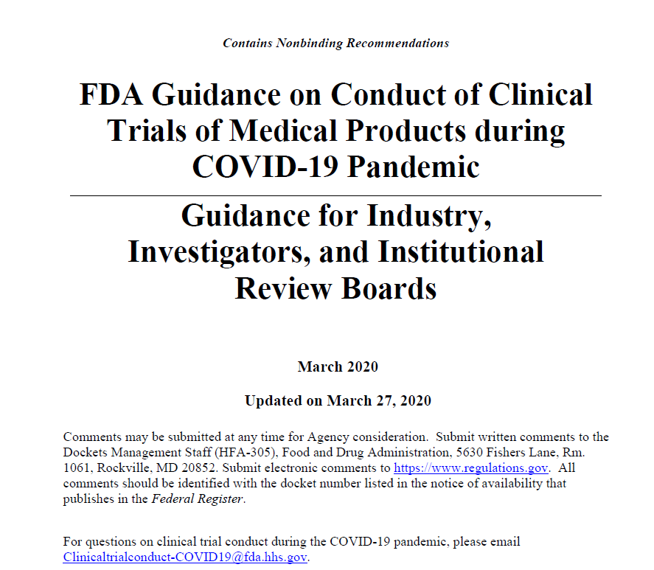
How Can Written Informed Consent be Obtained from VA Research Subjects Who are in COVID-19 Isolation?

Slide 7
How Can Written Informed Consent be Obtained from VA Research Subjects Who are in COVID-19 Isolation?
As referenced in FDA’s guidance, the following options are available to satisfy documentation requirements as approved by the IRB for written informed consent for patients in COVID-19 isolation who consent to be in VA research studies.
  Electronic methods of obtaining consent

Slide 8
How Can Written Informed Consent be Obtained from VA Research Subjects Who are in COVID-19 Isolation?
  When it is not possible to obtain informed consent electronically, the
  following steps can be considered:
    An unsigned consent form is provided to the patient by a healthcare worker who has entered the room.
    2. If direct communication with the patient in isolation is not feasible or safe, the investigator or delegated research staff obtains the patient’s phone number and arranges a three-way call or video conference with
            the patient,
            an impartial witness, and if desired and feasible,
            additional participants requested by the patient, e.g. next
        of kin.

Slide 9
How Can Written Informed Consent be Obtained from VA Research Subjects Who are in COVID-19 Isolation?
  3. To ensure that patients are approached in a consistent fashion, a standard process should be used that will accomplish the following:
    Identification of who is on the call;
    Review of the informed consent with the patient by the investigator (or their designee) and response to any questions the patient may have;
    Confirmation by the witness that the patient’s questions have been answered;
    Confirmation by the investigator that the patient is willing to participate in the trial and sign the informed consent document while the witness is listening on the phone; and
    Verbal confirmation by the patient that they would like to participate in the trial and that they have signed and dated the informed consent document that is in their possession.

Slide 10
How Can Written Informed Consent be Obtained from VA Research Subjects Who are in COVID-19 Isolation?
If the signed informed consent document will not be able to be collected from the patient’s location and included in the study records, the following two options are acceptable to provide documentation that the patient signed the informed consent document:
Option #1: Attestations by the witness who participated in the call and by the investigator that the patient confirmed that they agreed to participate in the study and signed the informed consent.
    Please note: ORD recommends that the documented verbal confirmation include information on the version of the IRB-approved informed consent document that was used, such as IRB-approved informed consent dated 03/30/2020, Version 1.0, or other type of designation such as IRB-approved on 03/30/2020.
    Option #2: A photograph of the informed consent document with attestation by the
    person entering the photograph into the study record that states how that photograph
    was obtained and that it is a photograph of the informed consent signed by the patient.

Slide 11
How Can Written Informed Consent be Obtained from VA Research Subjects Who are in COVID-19 Isolation?
A copy of the informed consent document signed by the investigator and witness should be placed in the patient’s trial source documents, with a notation by the investigator of how the consent was obtained, e.g. telephone.
  The trial record at the investigational site should document how it was confirmed that the patient signed the consent form (i.e., either using attestation by the witness and investigator or the photograph of the signed consent).
  The note should include a statement of why the informed consent document signed by the patient was not retained, e.g., due to contamination of the document by infectious material.
If the patient is unable to provide informed consent and there is a legally authorized representative, investigators should obtain consent from the participant’s legally authorized representative.

Slide 12
How Can Written HIPAA Authorizations be Obtained from VA Research Subjects Who are in COVID-19 Isolation?
Similar issues exist with obtaining written HIPAA authorizations from patients in COVID-19 isolation compared to obtaining written informed consent.
However, HIPAA is not analogous to the Common Rule or FDA regulations.

Slide 13
How can Written HIPAA authorization be Obtained from VA Research Subjects Who are in COVID-19 Isolation?
As a response to the COVID-19 health pandemic, HHS Office of Civil Rights (OCR) is exercising enforcement exceptions that apply to health care provider activities beyond treatment and would cover research-related care or treatment, such as with clinical trials.
Please note that HHS OCR guidance is not expanding or otherwise altering the HIPAA Privacy and Security Rules but simply provides that HHS OCR will use its enforcement discretion to not issue penalties for violations by covered entities responding to the COVID-19 public health emergency.

Slide 14
How can Written HIPAA authorization Be Obtained from VA Research Subjects Who are in COVID-19 Isolation?
Research HIPAA Authorizations combined with the Informed Consent may be obtained from the Subject in the manner addressed for Informed Consents. Research HIPAA Authorizations, VAF 10-0493 may be obtained remotely in the following ways:
Subject signs VAF 10-0493 at home and sends to VHA via mail, fax or takes a digital image to send via MyHealtheVet secure messaging. VHA accepts an image of a signed authorization the same as the original; or
Obtain verbal confirmation of the desire to sign, briefly document the circumstances of the signature on the authorization form and have two adult witnesses sign to authenticate the individual’s intent to provide authorization on the form. The two adult witnesses will need to be present during the consenting conversation and provide both their signature and title on the form. This option is only available during the COVID-19 crisis as verbal authorization is not normally permitted by HIPAA.
3. In addition, the IRB may approve to waive the HIPAA authorization requirement due to
challenges of obtaining authorization during the COVID-19 crisis.

Slide 15
Can a waiver or alteration of HIPAA authorization be used to disclose protected health information (PHI) when written HIPAA authorization cannot be obtained from VA research subjects who are in COVID-19 isolation?
VHA does not permit alterations of authorizations, so IRBs or Privacy Boards cannot grant an alteration of authorization eliminating the requirement for signatures or dates of the subject or the subject’s personal representative.
However, if a written authorization cannot be obtained from the subject who is in COVID-19 isolation or subject’s personal representative because he or she is unable to enter the hospital because of isolation precautions, the IRB or Privacy Board may approve a waiver of the requirements of written HIPAA Authorization provided the research meets the criteria for waiver of authorization in 45 CFR 164.512(i)(2)(ii). This will permit VHA to use and disclose PHI outside of VHA for research purposes under the HIPAA Privacy Rule.
As a reminder, when disclosing PHI outside of VHA for research purposes authority under the other applicable federal privacy laws is required in addition to the waiver.

Slide 16
VHA Directive 1200.05: VHA’s Use of Commercial IRBs
Amendment to VHA Directive 1200.05: VHA Directive 1200.05 was amended on March 3, 2020 permitting VA Facilities to use commercial IRBs for cooperative (multi-site) research activities as approved by ORD:
  “VA will permit use of a commercial IRB as an IRB of Record for VA facilities if it has been specifically designated by ORD as a commercial IRB that may serve as an IRB for cooperative research.”
VHA Directive 1200.05, Paragraph 5.b.
.

Slide 17
VHA Directive 1200.05: VHA’s Use of Commercial IRBs
VA’s intent was to initially limit the use of commercial IRBs to industry sponsored clinical trials in which the industry collaborator pays for the use of the commercial IRB.
If another entity is not paying for the commercial IRB, VA cannot use the commercial IRB for that study.
  The VA NPC cannot be the entity that pays for the commercial IRB.
The commercial IRBs VA uses must be vetted and approved by ORD.
Agreements must be negotiated between the commercial IRBs and VA in order to use the IRB.
VHA facilities may not contract directly with commercial IRBs nor enter into an agreement that has been executed by another institution or entity for use of a commercial IRB.
  Example: If your University has a contract with a commercial IRB for the IRB to provide IRB review services for the University, your VA cannot use their agreement to add the VA as a component of the University.

Slide 18
VHA Directive 1200.05: VHA’s Use of Commercial IRBs
VA has agreements with two commercial IRBs at the present time
  Advarra IRB
  WCG IRB
Some VA sites are already using these two commercial IRBs to participate in multi-site studies that they were selected to be in by the sponsors of the respective study:
  National Institute of Allergy and Infectious Diseases (NIAID)
  Regeneron Pharmaceuticals

Slide 19
VHA Directive 1200.05: VHA’s Use of Commercial IRBs: Requesting Use of a Commercial IRB
Requesting use of a Commercial IRB
  Do not submit an Institutional Review Board (IRB) Reliance Request Form) to ORD
  VA Facility (Not the Investigator) must provide the following information in a email to IRBRelianceandSIRBExceptions@va.gov with the subject line: “Commercial IRB Reliance Request”
    Name of Commercial IRB
    Name of VA Nonprofit Corporation
    Please state whether your VA Facility has been selected by the sponsor for a study that is using the commercial IRB (time-sensitive)

Slide 20
VHA Directive 1200.05: VHA’s Use of Commercial IRBs: Requesting Use of a Commercial IRB
Requesting use of a Commercial IRB
  Call for time sensitive issues:
      Ms. Priscilla Craig
      Ms. Sarah Rule or Dr. Karen Jeans
  Copy the Office of Research Oversight
    Ms. Priscilla Craig at priscilla.craig@va.gov
    Ms. Elizabeth Clark at Elizabeth.clark3@va.gov
    Dr. Kristina Borror at Kristina.borror@va.gov

Slide 21
Can the VA Facility Use the Commercial IRB for the study:
Information ORD has been Requesting When a VA Facility Informs ORD that it has an Investigator who will be Participating in a Multi-Site Study using a Commercial IRB
ORD requests the following information copying ORO if ORO was not included in the initial query:
  Whether the sponsor has confirmed your site’s participation in the study;
    Your VA Facility cannot be a subsite/sub-institution of another approved participating institution
  The name of the commercial IRB;
  Who is paying for the use of the commercial IRB;
  The name of the study; and
  The name of the VA Principal Investigator.

Slide 22
What is the Approval Process for Use of a Commercial IRB When your VA
Facility Informs ORD that it has an Investigator who will be Participating in a
Multi-Site Study using a Commercial IRB?
If ORD has negotiated an agreement with that commercial IRB, ORD and ORO will send your VA Facility
    The IRB Authorization Agreement
      The agreement language does not require modification. The only fields to complete are the name of the VA facility and the signatures and dates of the signatories.
    Local template for standard operating procedures to modify for use of the commercial IRB.
3. The IRB Authorization Agreement and SOPs can be done simultaneously.
Note: Submit each as soon as you have completed them to ORO.
4. ORD will send you a letter approving the use of the commercial IRB.
    Letters approving the use of the commercial IRB issued by ORD for use of the commercial IRB were individual for each study.
    ORD will be issuing commercial IRB authorization letters that cover multiple studies in which the sponsor pays for use of the IRB by your VA.

Slide 23
What is the Approval Process for Use of a Commercial IRB When your VA
Facility Informs ORD that it has an Investigator who will be Participating in a
Multi-Site Study using a Commercial IRB?
5. Do not update your Federalwide Assurance until ORO has informed you that you can proceed.

Slide 24
Important Tips to Remember: Use of Commercial IRBs
VA Nonprofit Corporations (NPC)
  The VA NPCs will also be signing the IRB Authorization Agreements to provide IRB oversight for studies in which they are engaged as defined by the Common Rule.

Slide 25

VHA Directive 1200.05: VHA’s Use of Commercial IRBs
Sponsor’s agreement to enter a VA Facility into the sponsor’s study being reviewed by the Commercial IRB
Entering into an IRB Reliance Agreement with a Commercial IRB
Sponsors of multi-site studies determine which sites are part of the study;
commercial IRBs do not choose sites for the sponsor.

Slide 26
Important Tips to Remember: Use of Commercial IRBs
  For VA Facilities that have already executed IRB Authorization Agreements with either Advarra or WCG as approved by ORD and ORO, your IRB authorization agreement only covers use for that specific study.
  ORD will be issuing IRB Authorization Agreements that cover multiple studies for which your VA is a participating site and the commercial IRB is the IRB of Record.

Slide 27
Important Tips to Remember: Use of Commercial IRBs
Once you have an agreement with a commercial IRB covering multiple studies (not a single study) and that commercial IRB has been added to your Federal Wide Assurance, you may rely on that commercial IRB anytime a multi-site study is proposed using that commercial IRB as long as:
  The sponsor has selected your VA as a participating site;
  The VA Facility or VA NPC is not paying for the IRB review; no money can be exchanged between the commercial IRB and the VA Facility due to Federal Acquisition Regulations (FAR);
  The sponsor is paying the commercial IRB for use by the VA Facility.
There is no requirement to let ORD or ORO know of subsequent sponsored studies that your VA is participating in using the commercial IRB, unless it is a COVID study, then please notify ORDCOVID19@va.gov.

Slide 28
Use of Designated Review by R&D Committees for Review and Approval of Expanded Access Programs
    VHA Directive 1200.01, Paragraph 9.e. allows a designated review process for specific types of research activities.
    Designated reviewer must be one of the following:
      R&D Committee Chair
      Voting member of the R&D Committee designated by the Chair

Slide 29
Use of Designated Review by R&D Committees for Review and Approval of Expanded Access Programs
  The following activities may be approved using designated review:
    Minor changes to a protocol required by R&D Committee following full board review;
    Final approval for protocols approved contingent on the full approval of a subcommittee if the subcommittee had not required major changes (as defined in local SOPS) to the protocol since the R&D Committee conducts its review;
    Final approval contingent on privacy office (PO)/information system security officer (ISSO) review;
    Exempt and Expedited human subject research protocols;

Slide 30
Use of Designated Review by R&D Committees for Review and Approval of Expanded Access Programs
  The following activities may be approved using designated review:
    Expanded Access – single patient expanded access approved by the IRB Chair or another appropriate IRB voting member; and
    Research that does not involve human subjects, biosafety level (BSL-3) or high containment, use of select agents or non-exempt quantities of selected toxins, USDA-regulated animal species, or any animal research involving more than momentary or distress to animals.

Slide 31
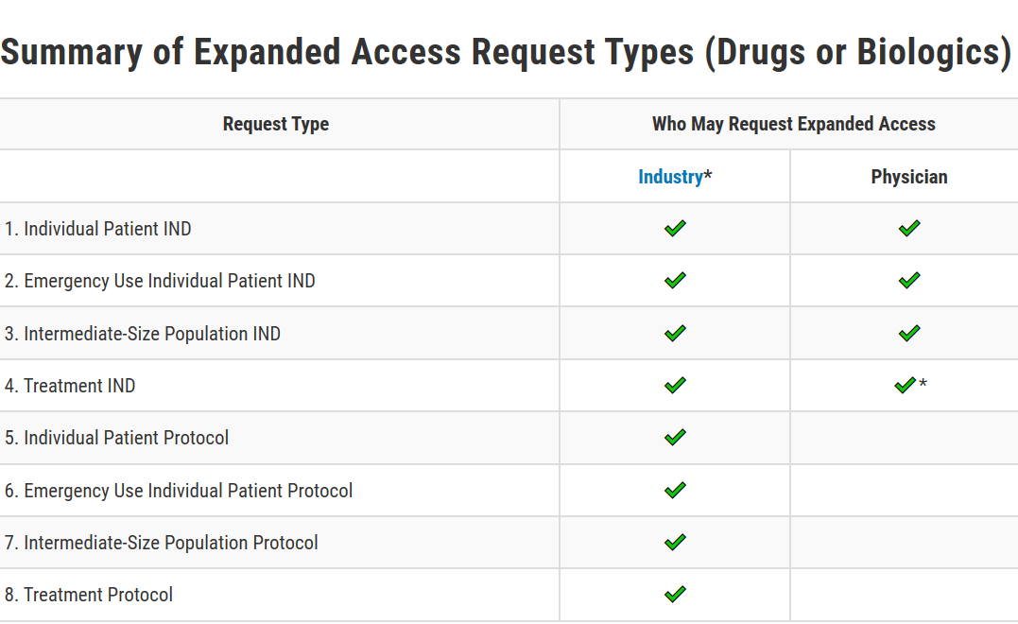
Summary of Different Types of Expanded Access: Drugs and Biologics
Source: https://www.fda.gov/news-events/expanded-access/expanded-access-how-submit-request-forms

Slide 32
Summary of Different Types of Expanded Access: Investigational Medical Devices
Type of Access | Brief Definition | FDA Approval Required? | Follow Up Report to FDA?
Emergency Use | Use of an investigational device when an individual patient is in a life-threatening situation and needs immediate treatment (there are no alternative options and no time to use existing procedures to get FDA approval for the use) | NO | YES
Compassionate Use | Use of an investigational device to treat or diagnose an individual patient or a small group of patients with a serious disease or condition when there are no available alternative options | YES | YES
Treatment Investigational Device Exemption | Use of an investigational device to treat or diagnose a group of patients with a serious or immediately life-threatening disease or condition when the device is also being studied for the same use under an approved Investigational Device | YES | YES

Slide 33
Use of Designated Review by R&D Committees for Review and Approval of Expanded Access Programs
Can a designated review process be used by the R&D Committee for other types of expanded access protocols, including intermediate population and treatment protocols?

Slide 34
Use of Designated Review by R&D Committees for Review and Approval of Expanded Access Programs
The designated review process can be used by the R&D Committee to approve expanded access for
  individual patients (non-emergency),
  expanded access for intermediate-size patient groups, and
  expanded access for widespread treatment use.
The expansion of use of designated review processes by the R&D Committee for any expanded access is part of ORD’s planned revision of VHA Directive 1200.01.
ORO is allowing discretionary enforcement of ORD policies in VHA Directive 1200.01 regarding use of designated review for any expanded access use prior to publication of an amendment to VHA Directive 1200.01.

Slide 35
Amendments vs. Changes Made to Eliminate Apparent Immediate Harm to Human Subjects
HOW ARE THEY RELATED?
AMENDMENTS
CHANGES MADE TO
ELIMINATE APPARENT
IMMEDIATE HARM TO
HUMAN SUBJECTS

Slide 36
If I am only Changing My Study Procedures Temporarily, to Eliminate Immediate Hazards to Subject safety, Do I Have to Notify the IRB?
Answer: YES.
You must notify the IRB whenever you are making any change in the IRB-approved protocol.
You do not have to wait to obtain IRB approval when making changes to eliminate immediate hazards to subject safety to implement those changes, but you must notify the IRB of the changes that were made, in the manner and timeframe required by written local policy.
In addition, you must notify any other applicable parties or individuals if required. For example, if the protocol was an industry-sponsored clinical trial, and the protocol stated that any modifications in the IRB-approved protocol require notification to the sponsor, reporting to the sponsor is required.

Slide 37
Can an Investigator Make a Change in the IRB-approved Method of Documenting Informed Consent Prior to Obtaining IRB Approval in Order to Eliminate Immediate Apparent Hazards to Human Subjects?
Answer: No.
The IRB has regulatory authority over both the process and documentation of informed consent in a non-exempt human subjects study as described in 38 CFR§16.111(a)(4).
Any changes in how informed consent documentation is obtained must be approved prospectively by the IRB.

Slide 38
Do I Have to Change my Consent Form or Reconsent my Subjects After I Implement Changes to Eliminate Immediate Apparent Hazards to Human Subjects?
Answer: No.
The IRB determines whether changes in the IRB-approved informed consent form or reconsenting of subjects is required. As part of the IRB approval criteria in 38 CFR§16.111(a)(4), the IRB is responsible for both the process and documentation of informed consent, including any revisions in either the process or documentation after the research is initially approved by an IRB.
ORD wishes to reinforce that IRB approval is not required for an Investigator to implement changes to eliminate immediate hazards to subjects.
.

Slide 39
If I am Permanently Changing my Study Procedures as a Result of the Pandemic, is an Amendment Necessary?
Answer: Yes.
If you are changing the conduct of the protocol permanently, please submit an amendment. This should be done in accordance with local IRB policies and procedures after initiating the change to eliminate immediate hazards to subject safety.
If this is not a permanent change and only a temporary modification to eliminate immediate hazards to subject safety, an amendment is not required.
If you are making changes to study procedures that not related to eliminating immediate hazards to subject subject, an amendment is necessary.

Slide 40
Use of Video and Communication Technologies in VHA Research
ORD working with OI&T: Memorandum

Slide 41
Summary
Multiple issues impacting human subjects studies involving human subjects protections
ORD will be releasing FAQs within days on the content covered in this seminar.
ORD is working with multiple other agencies and institutions
Guidance is continually evolving and changing

Slide 42
Questions?
Send ORD regulatory questions not related to COVID 19 to:
VHACOORDREGULATORY@VA.GOV
Send any COVID-19 questions to:
ORDCOVID19@VA.GOV

